Slide 1
Agenda
Intro to Search Dog Network
How we use mapping & navigation
Canine demo
Geocache exercise

Slide 2
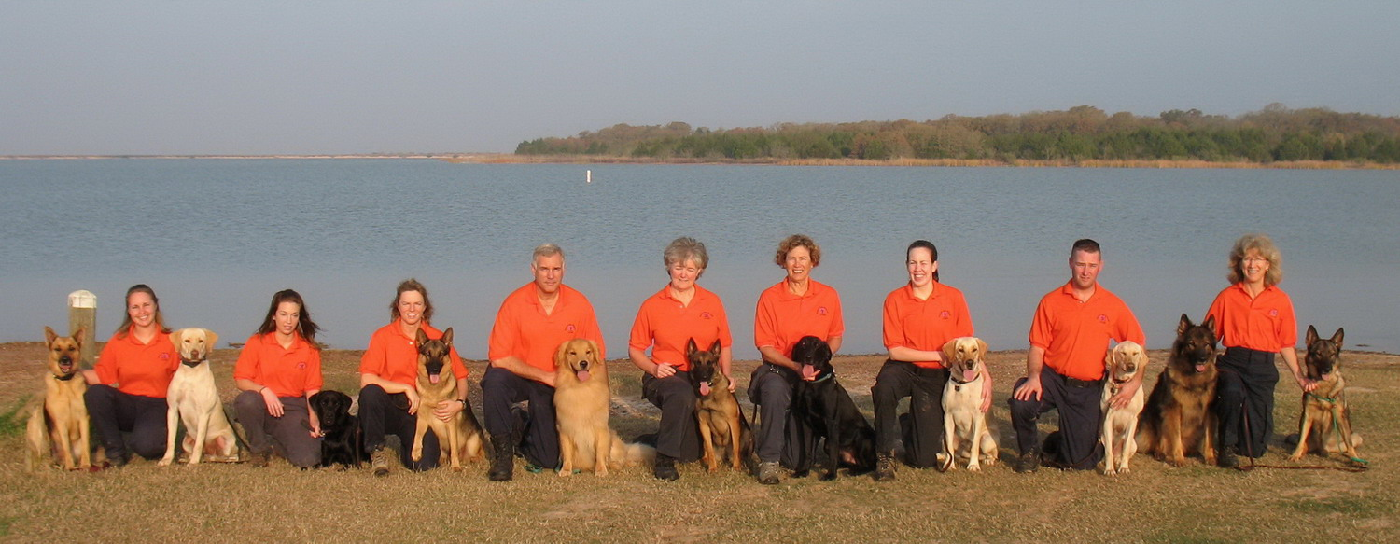
Search Dog Network
Our mission is to train, certify and deploy
professional canine search teams
to locate missing persons.
Serving our community since 1997
Notes:
2

Slide 3
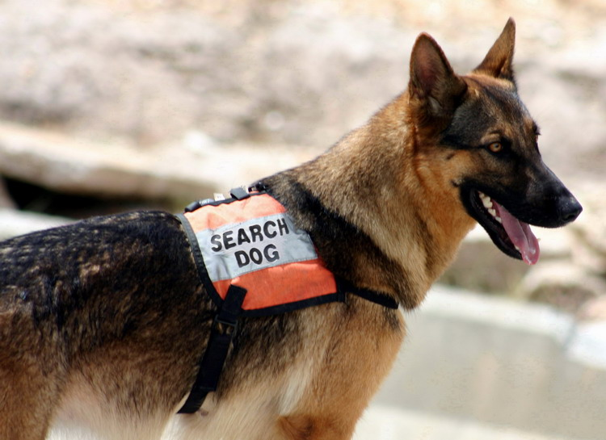
Canine Search Assets
Air Scent
Trailing
Human Remains (HR)
Disaster Search – Live
Disaster Search - HR
Water Search
65 search missions since 1997
Notes:
3

Slide 4
Training Standards
National
  National Criminal Records Check
  US Forest Service – Work Capacity Test “Pack Test” Moderate
  National Association for Search & Rescue (NASAR)
  National Narcotics Detector Dog Association (NNDDA)
  National Incident Management System compliant (NIMS)
State of Texas
  Radios compliant with Texas Interoperability Communications Plan
Search Dog Network
  Internal Standards exceed the National Standards
Notes:
4

Slide 5
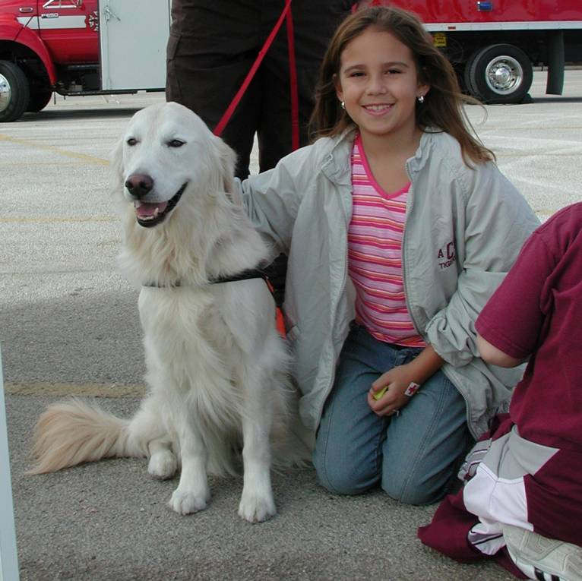
Community Education
Lost but Found- Safe and Sound
  Elementary School Students
  What children should do if
  they get lost
  Search Dog Demonstration
Canine Search & Rescue
  High School Students
  College Students
10 Community Events in 2009
Notes:
5

Slide 6
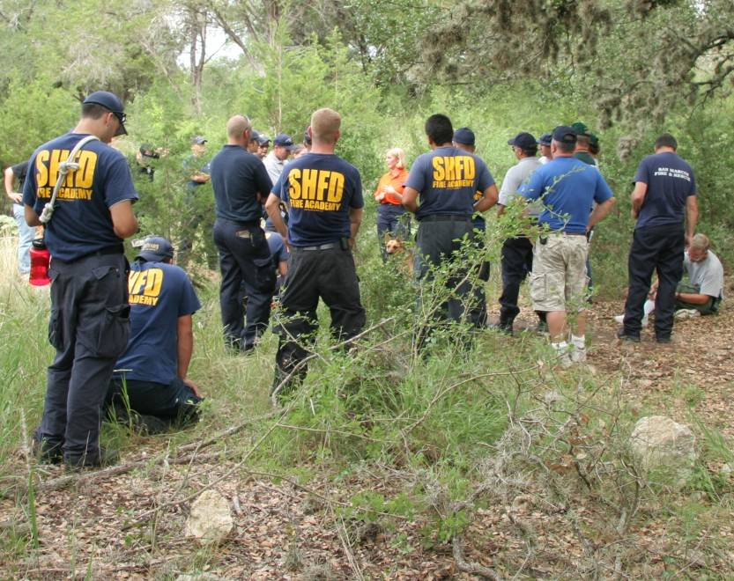
Emergency Responder Presentations
Search Dog 101
  Explains Canine Search Assets and how to use them most effectively
HR Detection Canines
  Explains the capabilities of Human Remains (HR) Dogs and when to use them
For More Information:
www.searchdogs.org
Notes:
6

Slide 7
Navigation & Mapping
Planning the Search
  Define Search Areas
  Deploy teams
During Search Operations
After Search Operations

Slide 8
In the Field
Tools and Techniques
  Terrain features
  Map, compass, and pace count
  GPS
Purpose
  Cover assigned area
  Progress reports
  GPS Tracks

Slide 9
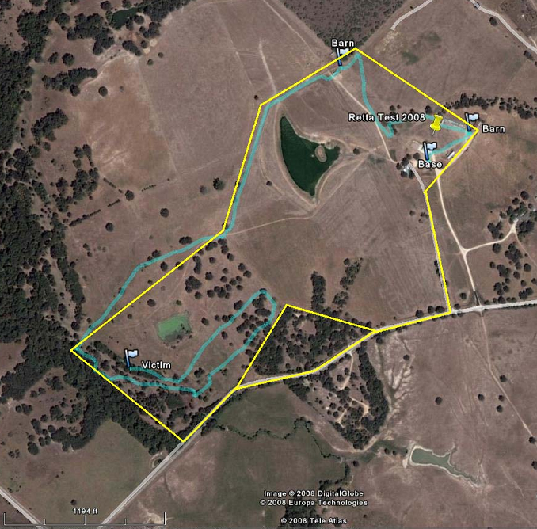

Slide 10
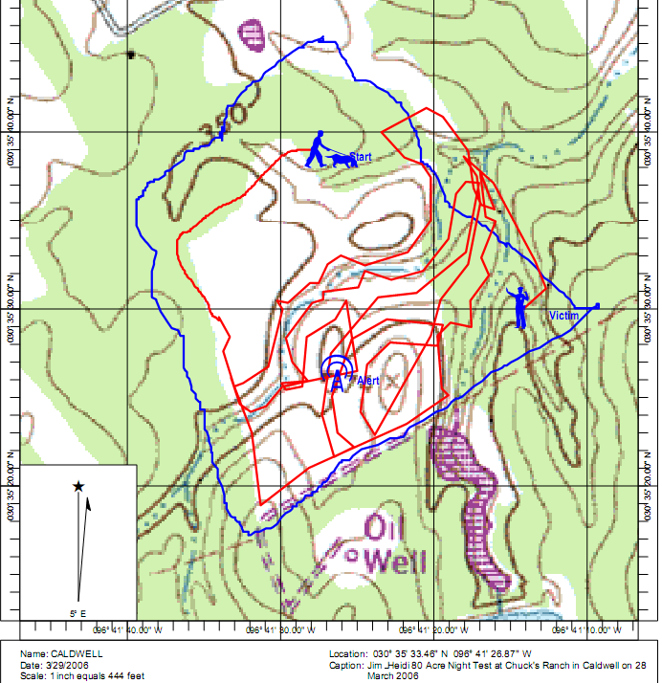

Slide 11
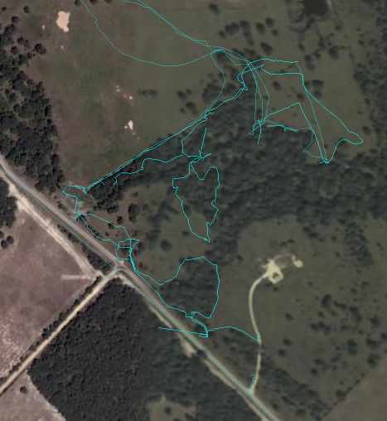

Slide 12
Mapping by the
Search Team Manager
Track teams in the field
Watch coverage
Plan next search areas
Verify coverage once teams return with GPS tracks

Slide 13
Next:
Canine Demo
Geocache Exercise

Slide 14
Geocache Exercise
Team up
Get a printout of coordinates
Borrow a GPS unit
Find each marker on the list
Write down its number
Find as many as you can in the time limit

Slide 15
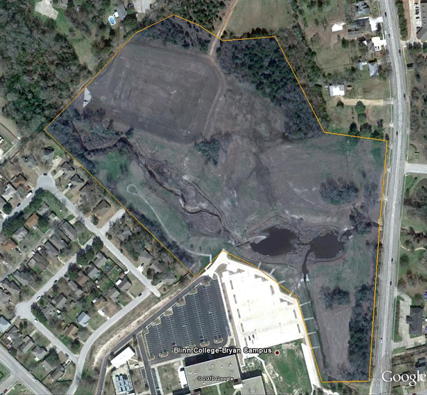
Exercise Limits
Stay within campus boundaries
Don’t cross roads or fences
Beware environmental hazards: participate at your own risk
Meet up at the “Rally Point”

Slide 16
Let’s Head Outside

